Slide 1
A/B testing basics: the main stats behind
Dimitriy Maidanyuk
maydanuk@gmail.com

Slide 2


What is A/B testing?

Slide 3


Basics of A/B test performance
The tested traffic is randomly sampled into portions among all variations.
Within the experiment, the visitor interacts with only 1 variation among all.
The experiment is being tested with the independent Bernoulli trials, where the target action accomplishment within some variation is called conversion (the successful case).

Slide 4
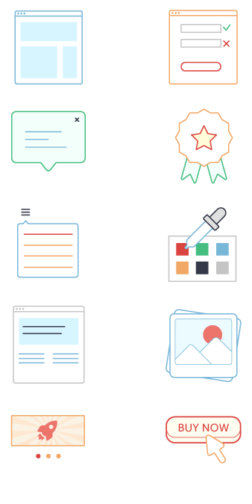
What can be tested?
UI elements (forms, colors, layouts)
Headlines, mottos
HTML elements and URLs
Banners and pop-ups
Navigation, UX elements
Scripts and various business logics

Slide 5
What is a typical A/B testing workflow?
Planning
Implementing
Analyzing results
Formulating a test hypothesis;
Defining a number of variations;
Defining goals;
Calculating Sample size;
Planning test duration;
Providing randomization among visitors during displaying content variations;
Gathering data;
Monitoring for a test health;
Calculating all needed metrics for a test;
Calculating a stopping criteria;
Hypothesis checking, make a final conclusion about test

Slide 6




Some issues of A/B testing
When should the test be stopped if the winner has been defined?
Is there enough traffic for conducting the test?
What will be the duration of the test?
Will there be the fall of the conversion during the test?
What if the traffic is nonhomogeneous?

Slide 7
Can these issues be solved?
Do not fix the sample size before the test start.
Be guided by the “minimum detectable effect”.
Utilize the sequential statistical analysis [4].
Use Bayesian interpretation of probability of win for a variation instead of the frequentist one [2].
Do not wait until the end of the test, but simultaneously maximize the win (the conversion number or profit) – as it is exactly what the client wants to do.

Slide 8
Minimum detectable effect
We should be guided by the minimum required sample size which proves statistically a significant difference between the variations.
Most of the tests are within this area

Slide 9
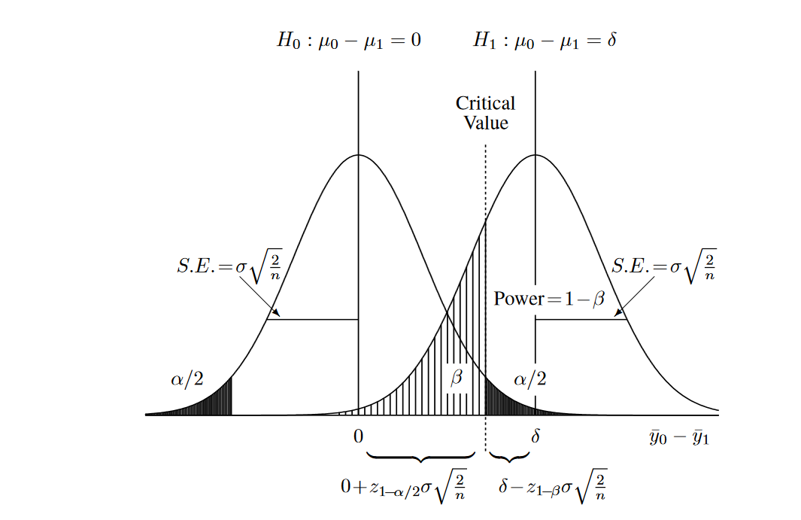
Sampling model for two independent sample case
Gerald van Belle. Statistical Rules of Thumb. http://www.vanbelle.org/chapters/webchapter2.pdf

Slide 10
The important stats definitions
Definition | Description
H₀ | Null (main) hypothesis, any suggestion about testing values
H₁ | Alternative hypothesis, controversial suggestion to null hypothesis
Type I Error (α) | Probability of rejecting the null hypothesis when it is true
Type II Error (β) | Probability of not rejecting the null hypothesis when it is false
Power (1-β) | Probability of rejecting the null hypothesis when it is false
Critical Value | The critical value defines the boundary between the rejection and no rejection regions.
Sample size, n | The number of observations
Conversions, c | The number of observations (unique) when a conversion is occurred

Slide 11
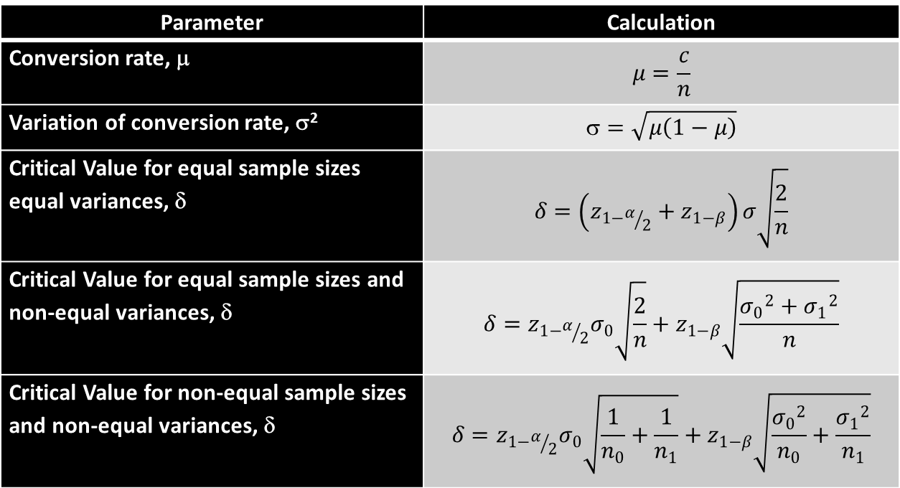
Stats formulas
Parameter | Calculation
Conversion rate, μ | $$μ=\frac{c}{n}$$
Variation of conversion rate, σ² | $$=\sqrt{μ\left(1−μ\right)}$$
Critical Value for equal sample sizes equal variances, δ | $$δ=\left(z_{1−α/2}+z_{1−β}\right)σ\sqrt{\frac{2}{n}}$$
Critical Value for equal sample sizes and non-equal variances, δ | $$δ=z_{1−α/2}σ_{0}\sqrt{\frac{2}{n}}+z_{1−β}\sqrt{\frac{{σ_{0}}^{2}+{σ_{1}}^{2}}{n}}$$
Critical Value for non-equal sample sizes and non-equal variances, δ | $$δ=z_{1−α/2}σ_{0}\sqrt{\frac{1}{n_{0}}+\frac{1}{n_{1}}}+z_{1−β}\sqrt{\frac{{σ_{0}}^{2}}{n_{0}}+\frac{{σ_{1}}^{2}}{n_{1}}}$$

Slide 12

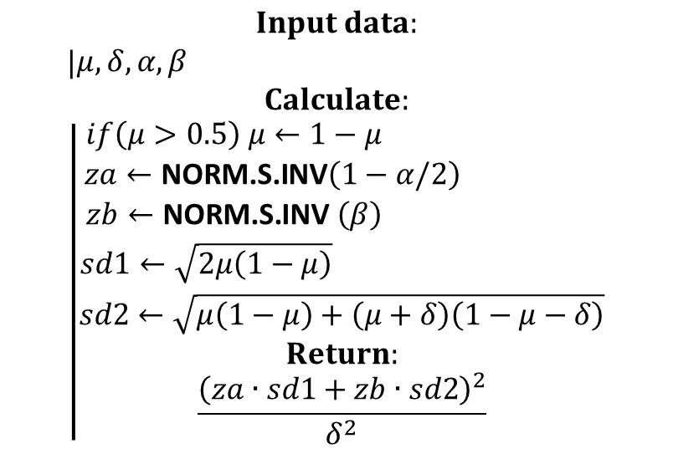
Algorithm for calculating the sample size*
$$\begin{matrix}Input data: \\ \begin{matrix}\begin{matrix}\begin{matrix}\left|\begin{matrix}μ,δ,α,β\end{matrix} \right. \\ Calculate: \\ \left|\begin{aligned}if\left(μ>0.5\right) μ←1−μ \\ za←\text{NORM}\text{.}\text{S}\text{.}\text{INV}\left(1−α/2\right) \\ zb←\text{NORM}\text{.}\text{S}\text{.}\text{INV} \left(β\right) \\ sd1←\sqrt{2μ\left(1−μ\right)} \\ sd2←\sqrt{μ\left(1−μ\right)+\left(μ+δ\right)\left(1−μ−δ\right)} \\ Return: \\ \frac{{\left(za∙sd1+zb∙sd2\right)}^{2}}{δ^{2}}\end{aligned}\right.\end{matrix}\end{matrix}\end{matrix}\end{matrix}$$
δ – Minimum Improvement in conversion rate want to detect
NORM.S.INV() - the inverse of the standard normal cumulative distribution function
Test for μ = 10%, $δ=1\%$, $α$ = 5%, β=80 %
Sample size = 14313 per variation
*According to: https://www.evanmiller.org/ab-testing/sample-size.html

Slide 13
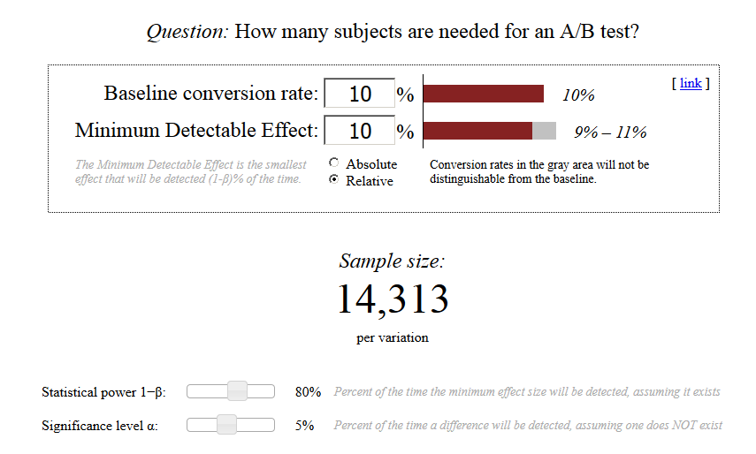
Evan Miller sample size calculator
https://www.evanmiller.org/ab-testing/sample-size.html

Slide 14

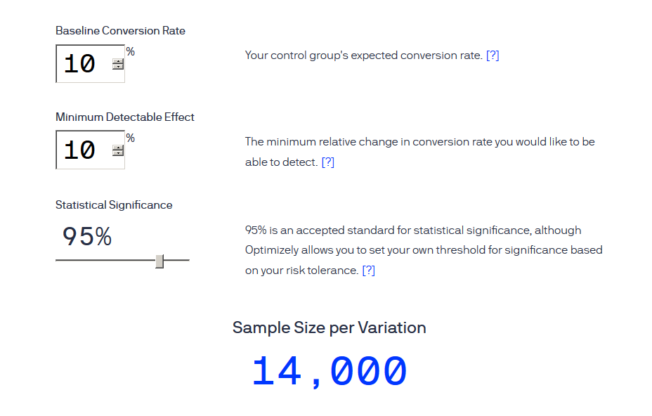
Optimizely Sample Size Calculator
https://www.optimizely.com/sample-size-calculator/?conversion=10&effect=10&significance=95

Slide 15
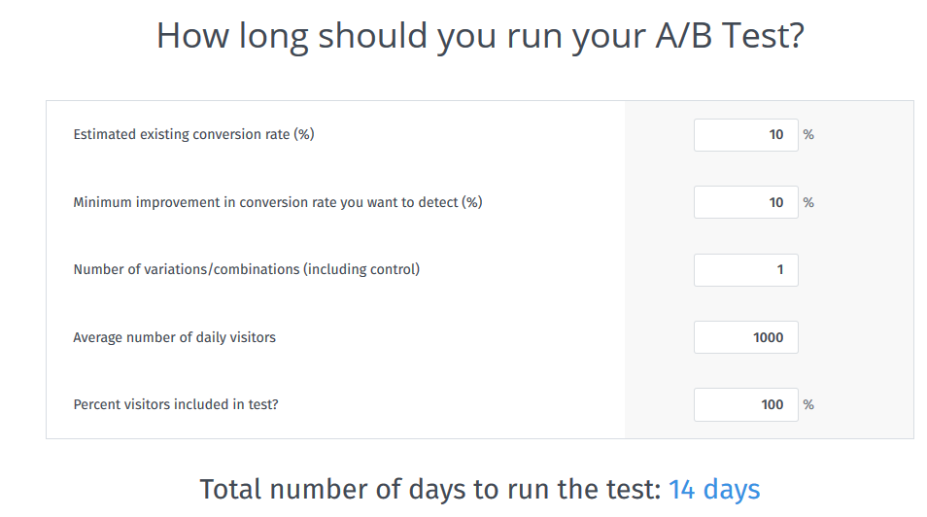
VWO sample size calculator
https://vwo.com/ab-split-test-duration/

Slide 16
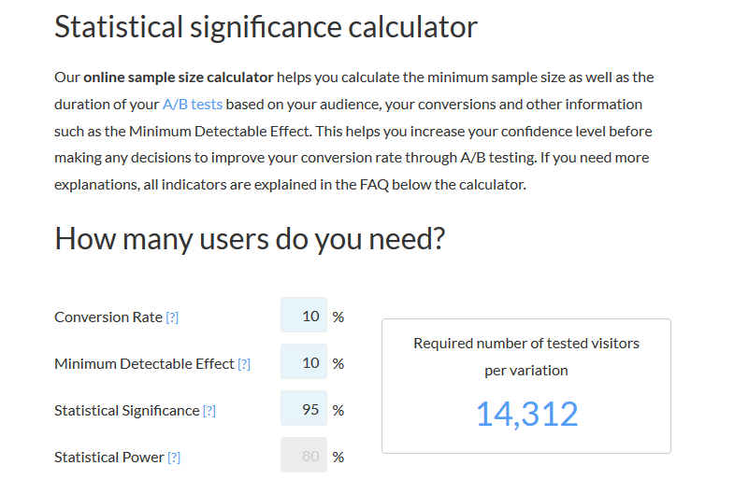
ABtesty sample size calculator
https://www.abtasty.com/sample-size-calculator/

Slide 17
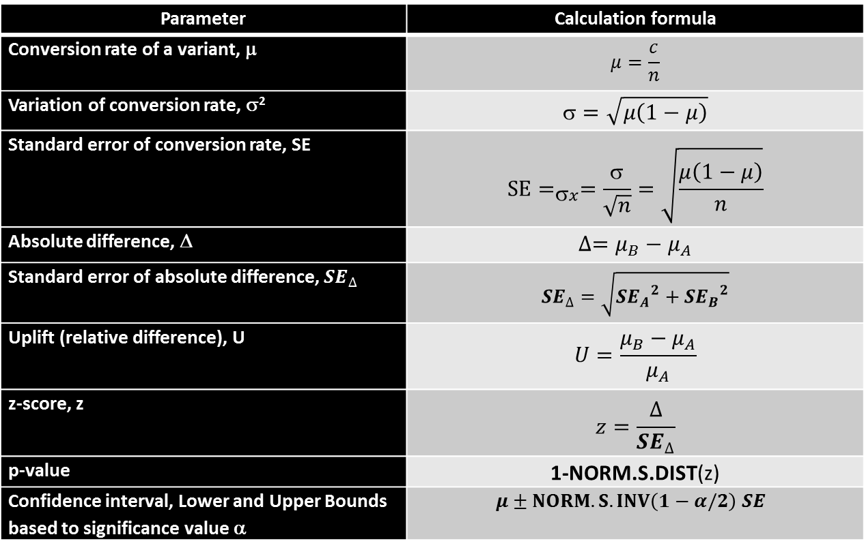
A/B test significance formulas for Z-test
Parameter | Calculation formula
Conversion rate of a variant, μ | $$μ=\frac{c}{n}$$
Variation of conversion rate, σ² | $$=\sqrt{μ\left(1−μ\right)}$$
Standard error of conversion rate, SE | $${SE=}_{σx}=\frac{σ}{\sqrt{n}}=\sqrt{\frac{μ\left(1−μ\right)}{n}}$$
Absolute difference, Δ | $$∆=μ_{B}−μ_{A}$$
Standard error of absolute difference, ${SE}_{∆}$ | $${SE}_{∆}=\sqrt{{{SE}_{A}}^{2}+{{SE}_{B}}^{2}}$$
Uplift (relative difference), U | $$U=\frac{μ_{B}−μ_{A}}{μ_{A}}$$
z-score, z | $$z=\frac{∆}{{SE}_{∆}}$$
p-value | 1-NORM.S.DIST(z)
Confidence interval, Lower and Upper Bounds based to significance value α | $$μ±NORM.S.INV\left(1−α/2\right) SE$$
A, B are testing variants, A is a control variant

Slide 18
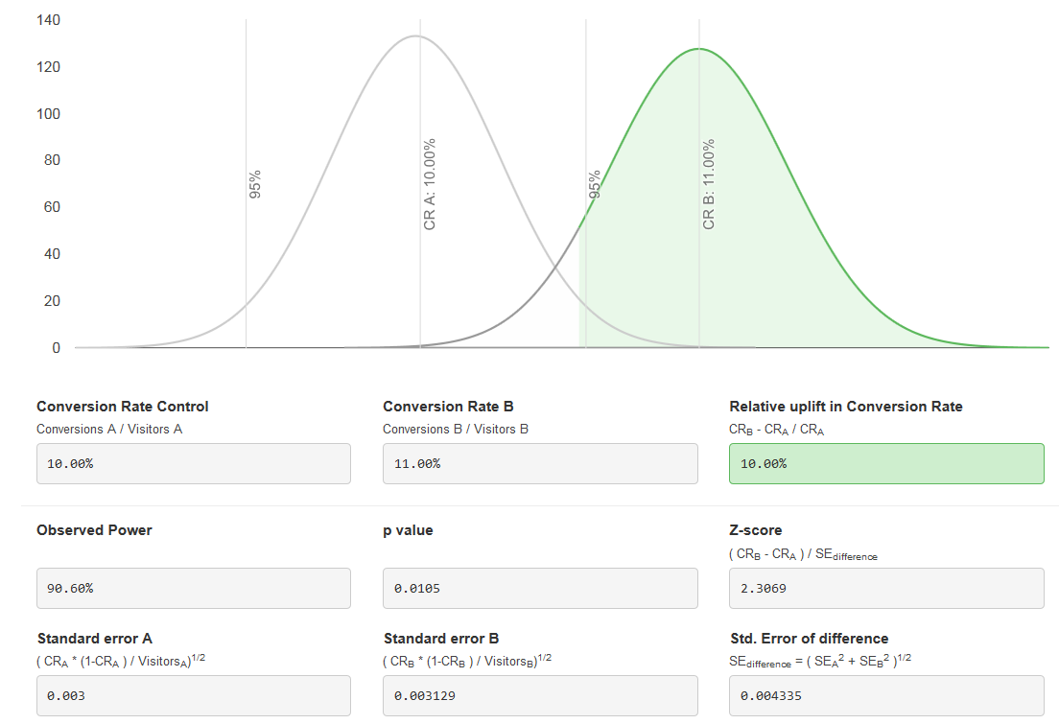
Z-test results for two samples
small value <0.05 indicates strong evidence against the null hypothesis (CRs are equals)
Why do we use Z-test ? Please refer to [13]

Slide 19
Articles worth your attention:
http://www.evanmiller.org/ab-testing/sample-size.html
http://www.evanmiller.org/bayesian-ab-testing.html
https://www.widerfunnel.com/goodbye-t-test-new-stats-models-for-ab-testing-boost-accuracy-effectiveness/
https://blog.optimizely.com/2015/01/20/statistics-for-the-internet-age-the-story-behind-optimizelys-new-stats-engine/
https://abtestguide.com/calc/
https://www.optimizely.com/sample-size-calculator
https://vwo.com/blog/ab-test-duration-calculator/
http://www.vanbelle.org/chapters/webchapter2.pdf
https://help.optimizely.com/Analyze_Results/How_long_to_run_an_experiment
https://signalvnoise.com/posts/3004-ab-testing-tech-note-determining-sample-size
https://www.abtasty.com/sample-size-calculator/
https://vwo.com/ab-split-test-significance-calculator/
https://keydifferences.com/difference-between-t-test-and-z-test.html

